Slide 1
Exploratory Analysis For Online News Popularity
- A deep insight analysis

Slide 2

The goal is to explore the dataset and find critical insights that can be used to influence potential article popularity.
To build machine learning models to predict the popularity of a given article.

Slide 3
Process Followed
Data Cleaning - Noise detection and removal
Subjective analysis - Using our intuition to evaluate a data variable/feature and decide whether a variable influences the popularity of the article or not.
Quantitative Analysis - How correct is our intuition? Here we carry our several analysis to accept or debunk our initial hypothesis
Normal Distribution Observation on the dataset
Feature Selection and Evaluation
Machine Learning Classification
Summary and Conclusion.

Slide 4
Grading the Shares
Exceptional = Top 95%
Excellent = Top 90%
Very Good = Top 80%
Good = Top 60%
Average = Top 50%
Poor = Top 35%
Very Poor = Rest

Slide 5
Making Recommendations For Good Articles
n_tokens_content should be less than 1500 words. The lesser the better.
n_tokens_title should be between 6 - 17 words.
n_unique_tokens should be between 0.3 - 0.8
num_hrefs is between 1 and 40 reference links
num_imgs should between 1 - 40 images
num_videos should be between 0 - 25 videos. The higher the lower the odds.
average_token_length should be between 4 - 6
The number of keywords in the metadata really influences the shares to a margin. The higher the value the better the shares chances. A value upward of 5 is recommended.
Here, it can be seen that the best articles with highest share popularity belongs to the "Others" channel. For a more concrete channel, The "Business" and "Entertainment" channels are great for the best popularity. Coming in third position will be the "World" and "Tech".
Best popular articles are usually posted on Mondays and Wednesday (and a bit of Tuesdays). Sundays and Saturdays (Weekends generally) are the worst days to publish an article.
Articles that talks about current trending are better for shares
From the scatterplot below, it can be seen than good articles will generally tend to have n_tokens_content less than 2000 and greater than 100 words

Slide 6
Feature Extraction & Selection
Here we will be extracting some of the best features we observed out from the data. The below criteria will be considered:
  Feature selection based on best hypothesis observed
  Feature Selection on the whole dataset
  Feature selection using fisher discriminal analysis
  Feature selection based on the best hypothesis observed but with a normal distribution (log transformation)
  Feature selection using fisher discriminate analysis on normal distribution dataset
  Feature Selection on the whole dataset - Normal Distribution

Slide 7
Variables of our features selection are listed below:
Feature selection based on best hypothesis observed - data_feature1
Feature Selection on the whole dataset - data_feature2
Feature selection using fisher discriminal analysis - data_feature_fisher
Feature selection based on the best hypothesis observed but with a normal distribution (log transformation) - data_feature1_normal
Feature selection using fisher discriminate analysis on normal distribution dataset - data_feature_fisher_normal
Feature Selection on the whole dataset - data_feature2_normal
The KNN model which gave the best accuracy of 49.11% was based on using the all the data-set feature and number of neighbors of 71. Although this was the best accuracy discovered, there wasn’t much difference with the other models. For example, using all the features gave an accuracy less than 1 % of the highest accuracy observed.

Slide 8
Random Forest has the best result for this classification task reaching an accuracy of 51.4%. Due to the nature of Random forest being able to set different numbers of decision trees, features, tree depth, splitting criteria, and others it tends to require a lot of parameter tuning.
The maximum accuracy observed with SVM was 50,58% . An observation with SVM is that training starts becoming increasing as the number of polynomial degrees increases, training examples increases, C value rises and also the number of features increase which basically makes the model become more complex to draw an hyperplane for separating the classes.

Slide 9
GRAPHS

Slide 10
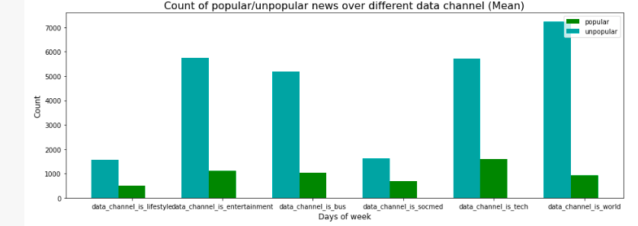
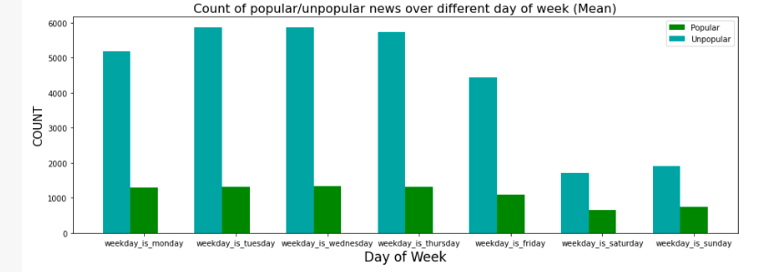

Slide 11
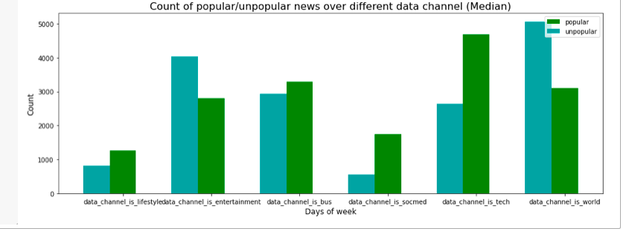
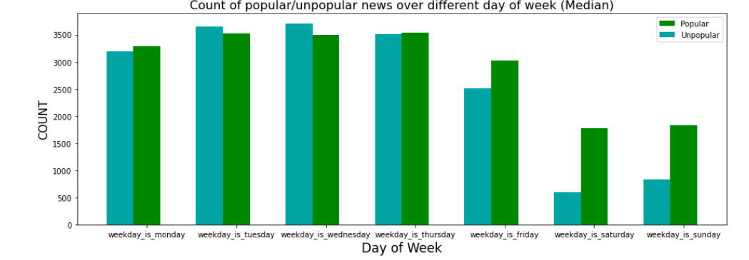

Slide 12
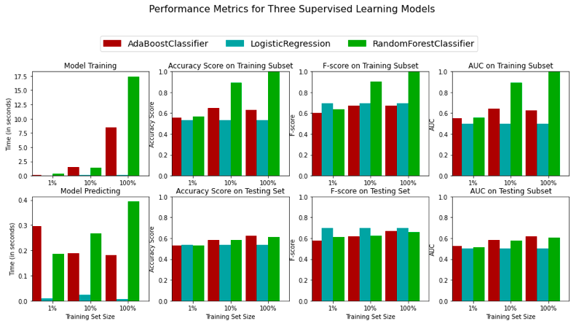

Slide 13
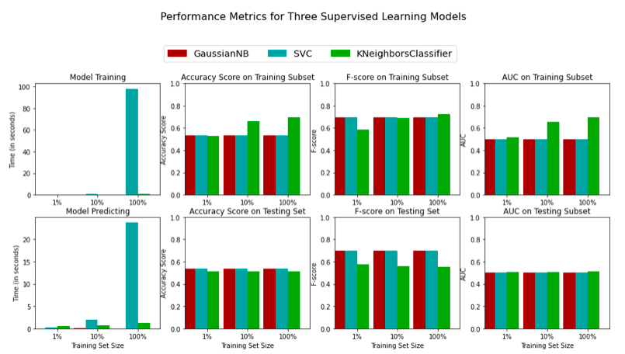

Slide 14
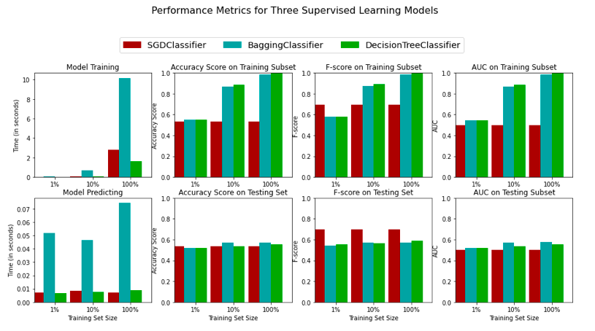

Slide 15
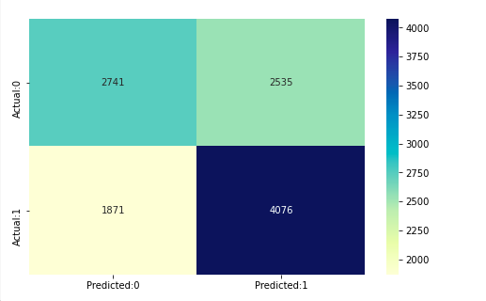

Slide 16
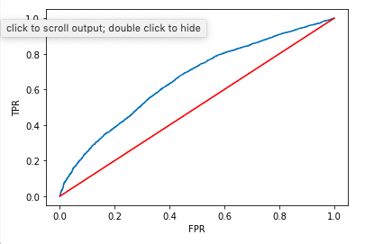

Slide 17
Summary and Conclusion
In this project we analyzed the given online news data set and were able to clearly observe some interesting patterns that good articles do have in common. We initially carried out a subjective analysis which was based on our own intuition and because we understand it is easily possible for human intuition to be biased or crowded from past experience, and use a quantitative analysis to confirm our initial hypothesis by doing univariate analysis using scatter plot, boxplot, and barplot of each feature with the shares feature.

Slide 18
Although our main gain is to build important insight about how popularity of articles are defined, we also went ahead in seeing how to predict the popularity of an article. Seven popularity classes were derived from the shared class and three machine learning models were built to be able to predict the popularity of the model. In order to be able to tune the models for better performances we consider different feature selection techniques, but these feature selection techniques didn’t really have much influence on the performance of the machine learning models.
The best machine learning model was the Random Forest which was able to attain an accuracy of 51.4% on the testing data-set. Some of the reasons for this low accuracy score is as a result of the large variance in the data set and also the imbalance in the class distribution which drives the prediction models to be bias towards popularity classes with more articles.

Slide 19
From the insight analysis carried out on the data-set the following are some of the things we recommend to improve the popularity of an article:
The number of words in the article should be less than 1500 words. The lesser the better.
Article title shouldn’t be too long or too short. 6 – 17 words is the ideal number of words to have for titles.
Articles should have a good amount of images. Between 1 – 40 images is great.
Also having a couple of videos is also nice for article popularity, but not too much. The higher the lower the odds.
Easy to read words helps to improve article popularity.
The number of keywords in the metadata really influences the shares to a margin. The higher the value the better the shares chances. A value upward of 5 is recommended.
Articles referencing popular articles have a higher chance of improving their own popularity.
Increase the number of popular unique words in the article to increase the chances of having better popularity.
Avoid the use of longer words in the articles.
Best popular articles are usually posted on Mondays and Wednesday (and a bit of Tuesdays). Sundays and Saturdays (Weekends generally) are the worst days to publish an article.
Articles that talk about current trends tend to have higher popularity.
Increase the amount of subjectivity in the title and content.
The "Business" and "Entertainment" channels are great for the best popularity. Coming in third position will be the "World" and/or "Tech" channels.

